Slide 1
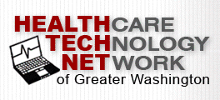

Medical Travel & Tourism
October 9, 2015
by Scott Pickens

Slide 2
Global Medical Tourism Market
$38.5B - $55B
2

Slide 3
Global Medical Tourism Market
$38.5B - $55B
≈1.25M Americans traveled abroad for medical treatment (in 2014)
≈ 1M foreign patients sought care in the US in 2014
Up to 50M medical tourists worldwide annually
(OECD estimates)
3

Slide 4
Definitions
Medical Travel
When a patient travels outside his/her local healthcare market for healthcare services
  Inbound: Patients from other countries traveling TO the US to receive medical care
  Outbound: U.S. patients traveling to other countries to receive medical care
  Domestic: U.S. patients traveling within the U.S. to receive medical care outside their geographic area, typically to a Center of Excellence in another state/region (often includes direct-to-employer contracting capability)
Medical Tourism
Combining tourism activities with medical travel – patient and/or family
4

Slide 5
Why travel for medical care?
Cost of care
Quality of care
Access to advanced technology
Quicker access to care
Access to certain procedures
Patient Experience
Anonymity
Value Added Vacation
Priorities vary with circumstance
5

Slide 6
Top destinations & services
United States – transplants, neurosurgery, psychiatry as well as orthopedic, cardiac, cancer surgery and broad base of other medical specialties and sub-specialties
Brazil – cosmetic surgery
Hungary – dentistry
Costa Rica – knee surgery, dentistry
India – orthopedic and cardiac surgery
South Korea – cosmetic surgery, cancer & spinal treatments
Malaysia – health screenings
Mexico - weight loss surgeries, cosmetic surgeries
Singapore – cancer, stem cell treatments
Israel – IVF specialty treatments
Barbados – fertility treatments
Thailand – broad base of surgeries
Turkey – many US trained doctors providing eye, cardiac, cancer, orthopedic surgeries
6

Slide 7
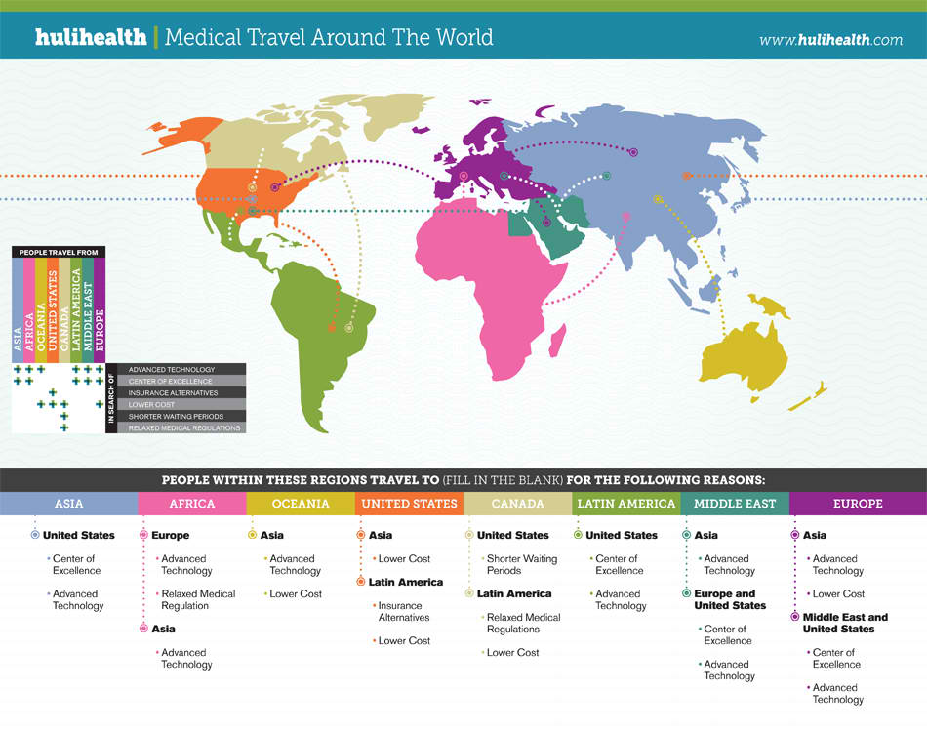
7

Slide 8
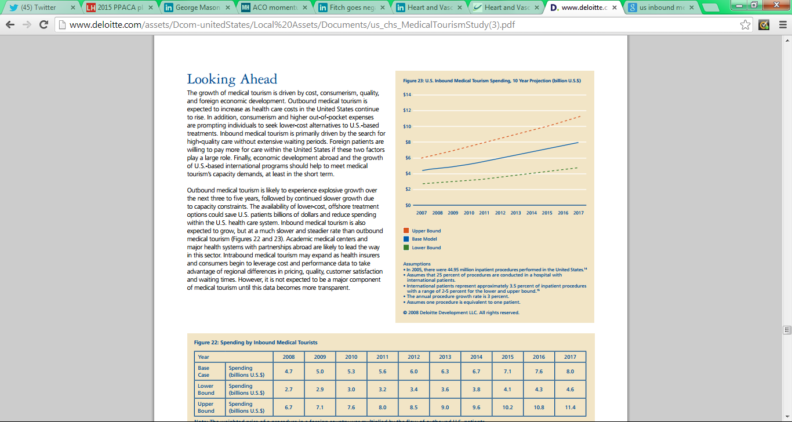
In-Bound market size ≈$8B by 2017
The United States is now one of the top three destinations worldwide for medical travel.
Three Main Customer Types - Individuals (international retail &/or digital consumers) - Foreign based employers
Foreign based payers (governments, others)
US Employers (OCONUS employees)
8

Slide 9
Who is coming to US?
Four countries are expected to account for 64% of the projected US inbound travel rate growth from 2012 through 2018¹
  Canada (29% of expected total growth)
  China (19%)
  Mexico (9%)
  Brazil (7%)
¹Source: US Department of Commerce; total figures include medically-related travel and reflect overall market trends
9

Slide 10
International Patient Profile
Cash-paying patients represent approximately ½ of all patients.
Upper middle income until brand is established.
Access, quality/innovation , and bundled prices have become key drivers in decisions by international inbound patients
Most sought for inbound procedures are orthopedic, spine, cardiac (excluding dental and cosmetic)
US inbound patients recognize US regulatory & accreditation standards support good to high quality.
10

Slide 11
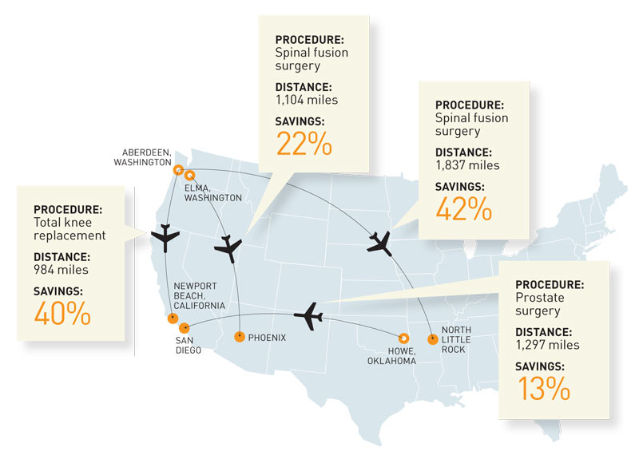
Cost Drives Domestic Medical Travel
11

Slide 12
Why Attract Medical Travelers now?
  Inevitable transition to value based care will decrease provider revenue.
  The only way to survive is to make it up in volume…
  IF you can maintain margin.
  Cost management is critical.
  Segment targeting is critical.
  Marketing & sales prowess is critical.
  Speed to market is critical.
12

Slide 13
Effective Medical Tourism Programs
Increase key performance metrics by leveraging assets & capacity:
↑ Revenue
↑ Brand Recognition
↑ Market Share
↑ Margin
Additionally:
Fully monetize Center of Excellence & bundling/VBR investments (domestic & int’l)
Utilize a combination of digital, in-market traditional as well as channel & partner-based marketing, sales strategies to increase volumes & associated revenue
13

Slide 14
What are you selling?
What services….and at what prices?
What are your differentiators? (Consider why people travel)
You may not be as different as you think.
Tourism is in the eye of the visitor.
14

Slide 15
Who are you selling to?
Direct to employer
Direct to Health Plan/TPA
To employer or other party through high performing network
Direct to consumer
Government
Other?
15

Slide 16
What factors do you analyze?
  Match your offering
  Service
  Price
  Access
  Quality
  Patient Experience
  To potential segments
  Geography
  Incidence/prevalence
  Age
  Gender
  Income
  Industry
  Payer Type
  Competition
16

Slide 17
How Are You Marketing & Selling?
Direct
Channel Partners
Traditional
Digital et al.
Some key questions include:
Will you be transparent to all parties in your pricing?
How do you expect prospective patients to engage with you – before, during and after the sale? Before, during and after the medical service?
What incentives will you offer, if any?
17

Slide 18
What MT technologies/platforms exist?
Some medical travel, trading & marketing platforms include:
www.voyagermed.com
www.medigo.com
www.surgiprice.com
www.medibid.com
www.onlinemedicaltourism.com
www.surgerycenterok.com
www.monticellosurgery.com
18

Slide 19
Fixed Pricing Means Bundles
Fixed pricing for a bundled service package is a must – risk moves to the provider
Proper pricing is both competitive & allows for steerage strategies
Bundle issues: scope – codes, tests, post surgical care, sg&a recovery, total pricing, risk sharing/p4p, payment timing, revenue attribution and distribution, proof of care/reconciliation
19

Slide 20
MT Program Issues- examples
Prior qualification of patients
Administrative work flow
Patient process flow
Continuity with home market providers pre- and post-care, including but not limited to primary care and rehab/PT/OT
Danger of readmission in a different hospital
Coordination of care across IP and OP settings (e.g., cancer)
20

Slide 21
Questions? Contact us…
Scott Pickens
Scott.Pickens@arlingtonhealthcaregroup.com
703-887-6615
www.ArlingtonHealthcareGroup.com
21

